Slide 1
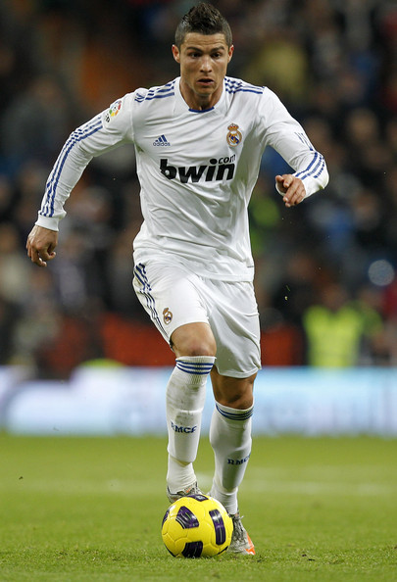
Cristiano Ronaldo

Slide 2
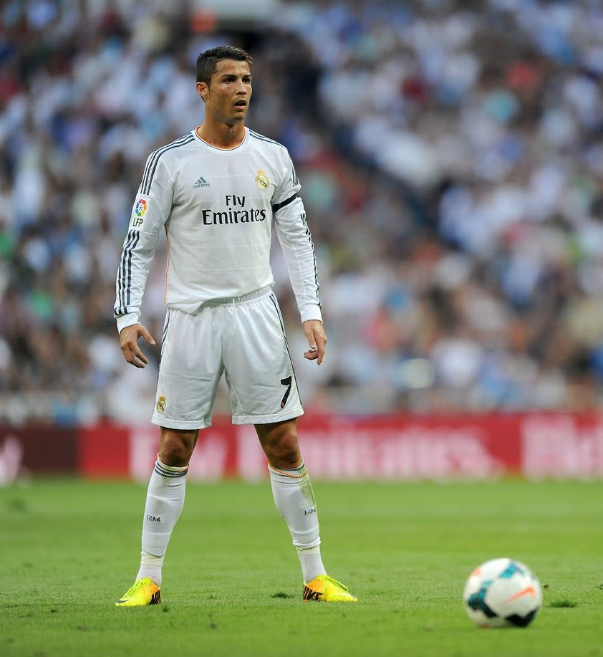
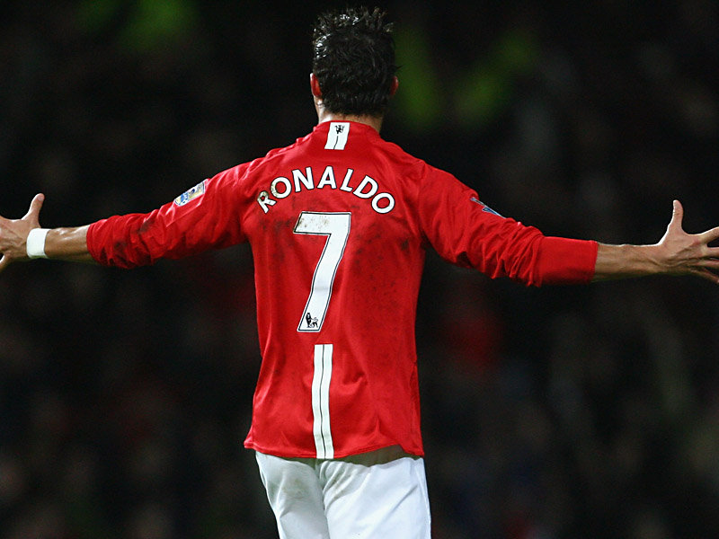
“I don’t have to show anything to anyone. There’s nothing to prove.”
-Cristiano Ronaldo
Notes:
Great players in all sports are always compared to other great players. Ronaldo shows in this quote that he doesn’t have to prove anything, and that he has already shown that he is great.

Slide 3
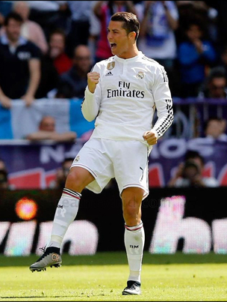
First player to score in every minute of a game
Notes:
He completed this record in the 2014 season.

Slide 4
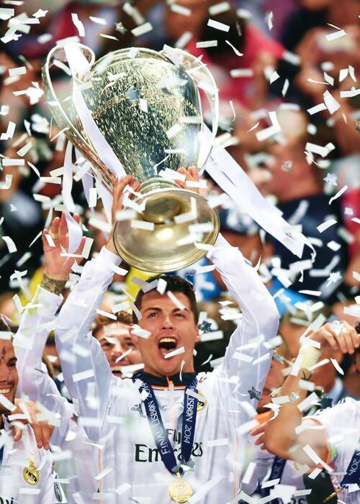
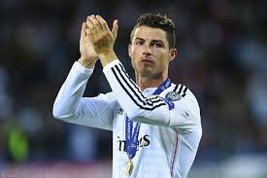
Most goals scored in Champions League history at 88 goals.
Notes:
Real Madrid won the UEFA Champions League in 2014. Ronaldo scored 17 goals in the Champions League that year.

Slide 5
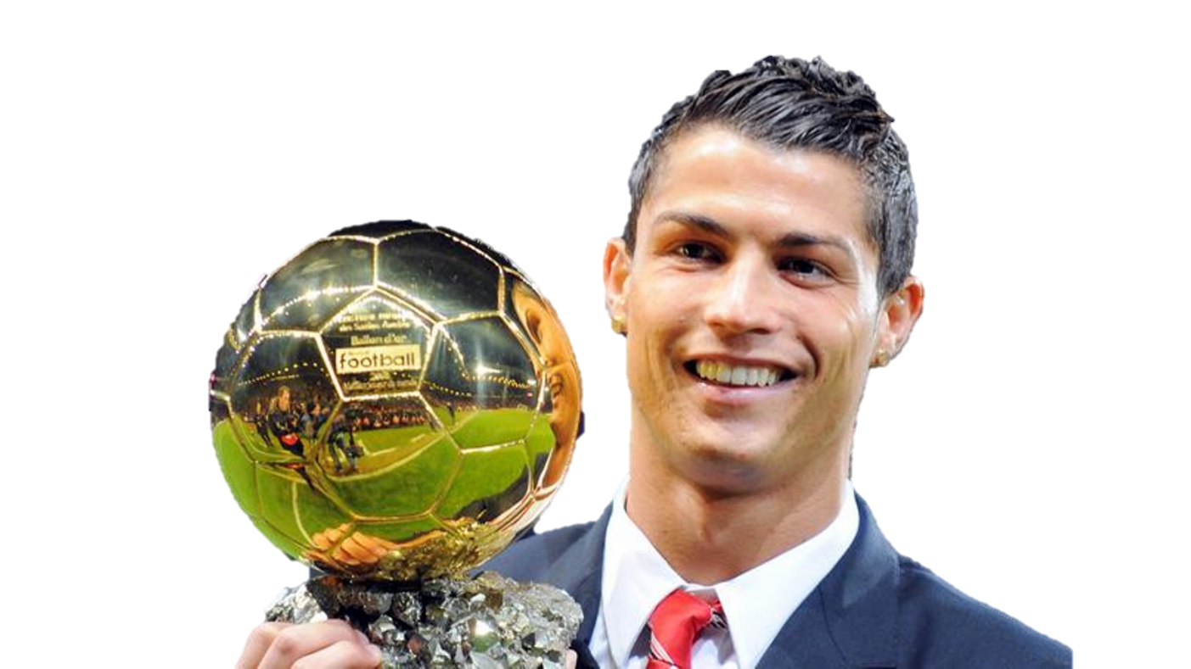
He won the Ballon d’or in 2008, 2013, and 2014, becoming the fifth player to win three or more in his career
Notes:
The Ballon d’or is the FIFA MVP, rewarded to the player who did the best in all competitions over the past calendar year. He was the first player to win the award for two different teams. He won it with Manchester United in 2008 and then with Real Madrid in 2013 and 2014.

Slide 6
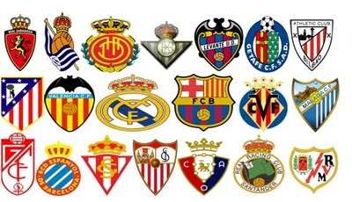
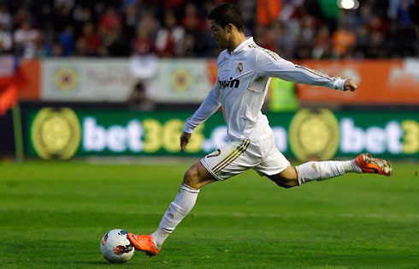
First player to score against every team in La Liga in a single season
Notes:
There are 20 total teams in La Liga.

Slide 7
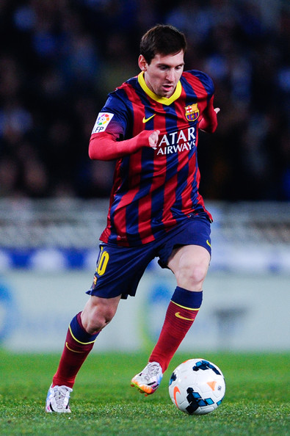
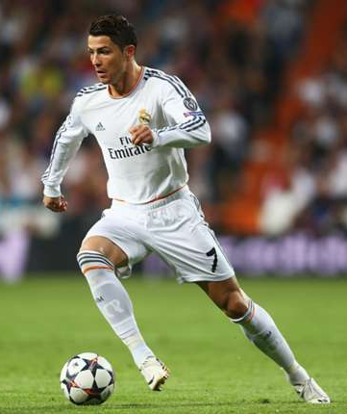
First player to score more than 25 goals in five straight La Liga seasons (shared with Lionel Messi)
Notes:
Shares nine other world wide records with Lionel Messi.

